Slide 1
Multi-layer Perceptron
  Majority of interesting problems are not linearly separable.
  That problems can be made linearly separable if we can work out how to transform the features suitably.
  Consider making more complicated networks.
  Learning in the neural network happens in the weights. So, to perform more computation it seems sensible to add more weights.
  There are two things that we can do: add some backwards connections, so that the output neurons connect to the inputs again, or add more neurons.

Slide 2
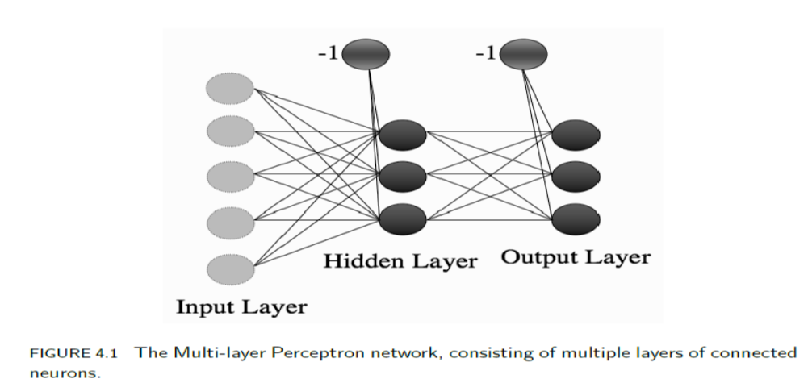
  The first approach leads into recurrent networks. but are not that commonly used.
  We will instead consider the second approach. We can add neurons between the input nodes and the outputs, and this will make more complex neural networks,

Slide 3
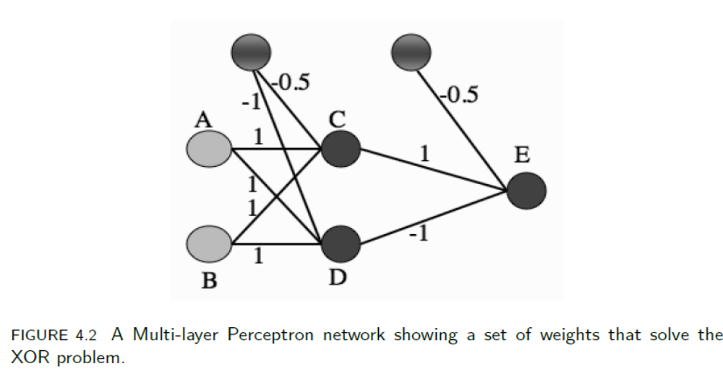
  XOR: Input (1, 0) corresponds to node A being 1 and B being 0.
  The input to neuron C is therefore −1 × 0.5 + 1 × 1 + 0 × 1 = −0.5 + 1 = 0.5. This is above the threshold of 0, and so neuron C fires, giving output 1.
  For neuron D the input is −1 × 1 + 1 × 1 + 0 × 1 = −1 + 1 = 0, and so it does not fire, giving output 0.
  Therefore the input to neuron E is −1×0.5+1×1+0×−1 = 0.5, so neuron E fires.

Slide 4
  GOING FORWARD:
  we start at the left by filling in the values for the inputs.
  We then use these inputs and the first level of weights to calculate the activations of the hidden layer, and then we use those activations and the next set of weights to calculate the activations of the output layer.
  Now that we’ve got the outputs of the network, we can compare them to the targets and compute the error.
  We need to include a bias input to each neuron.
  By having an extra input that is permanently set to -1, and adjusting the weights to each neuron as part of the training.
  Thus, each neuron in the network (whether it is a hidden layer or the output) has 1 extra input, with fixed value.

Slide 5

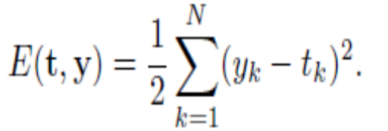
  GOING BACKWARDS: BACK-PROPAGATION OF ERROR
  The error function that we used for the Perceptron was where N is the number of output nodes.
  However, suppose that we make two errors. In the first, the target is bigger than the output, while in the second the output is bigger than the target. If these two errors are the same size, then if we add them up we could get 0, which means that the error value suggests that no error was made.
  To get around this we need to make all errors have the same sign.
  sum-of-squares error function

Slide 6
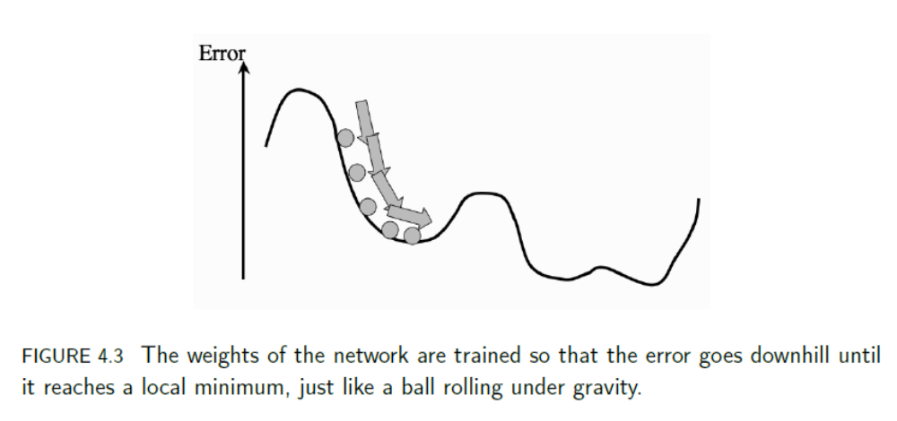
  If we differentiate a error function, then it tells us the gradient of that function, which is the direction along which it increases and decreases the most.
  Since the purpose of learning is to minimize the error, following the error function downhill (in other words, in the direction of the negative gradient) will give us what we want.

Slide 7
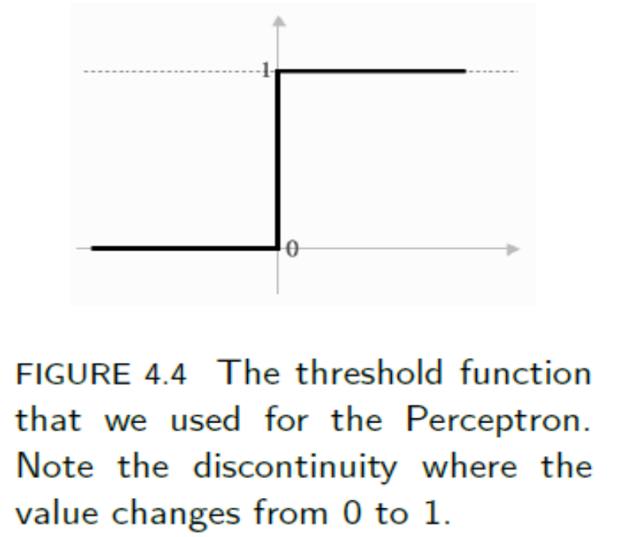
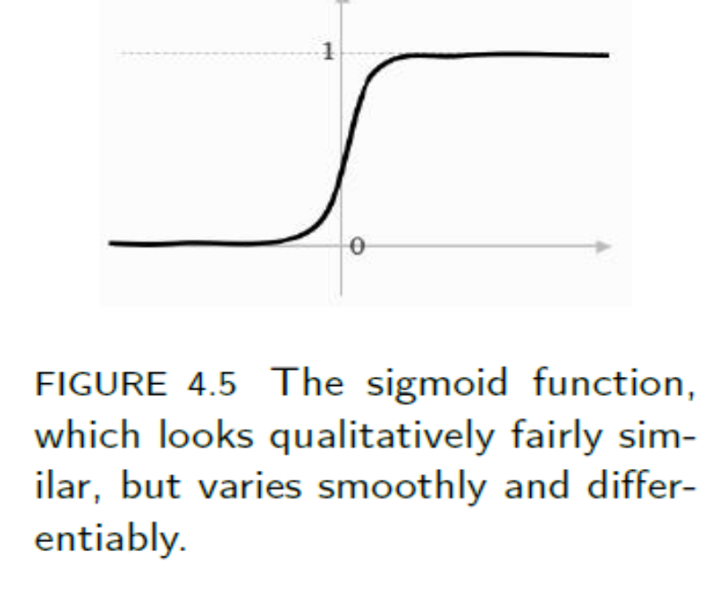
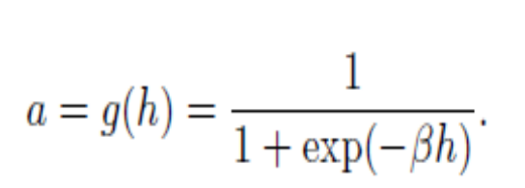
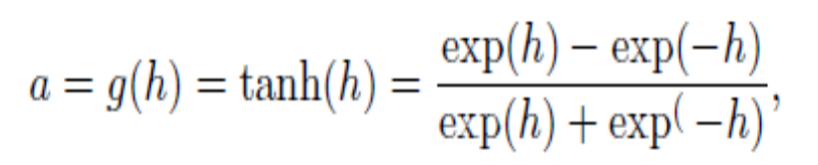
Activation Function
This is a different but similar function; it is still a sigmoid function, but it saturates (reaches its constant values) at ±1 instead of 0 and 1, which
is sometimes useful. It also has a relatively simple derivative: We can convert between the two easily, because if the saturation points are (±1), then we can convert to (0, 1) by using 0.5 × (x + 1).

Slide 8
  So now we’ve got a new form of error computation and a new activation function that decides whether or not a neuron should fire.
  We can differentiate it, so that when we change the weights, we do it in the direction that is downhill for the error
  we’ve fed our inputs forward through the network and worked out which nodes are firing.
  Now, at the output, we’ve computed the errors as the sum-squared difference between the outputs and the targets
  What we want to do next is to compute the gradient of these errors and use them to decide how much to update each weight in the network.

Slide 9
  We will do that first for the nodes connected to the output layer, and after we have updated those, we will work backwards through the network until we get back to the inputs again.
  There are just two problems:
  for the output neurons, we don’t know the inputs.
  for the hidden neurons, we don’t know the targets; for extra hidden layers, we know neither the inputs nor the targets.

Slide 10
  The Multi-layer Perceptron Algorithm
  There are L input nodes, plus the bias, M hidden nodes, also plus a bias, and N output nodes, so that there are (L+1)×M weights between the input and the hidden layer and (M+1)×N between the hidden layer and the output.
  The sums that we write will start from 0 if they include the bias nodes and 1 otherwise, and run up to L,M, or N, so that x0 = −1 is the bias input, and a0 = −1 is the bias hidden node.
  The algorithm that is described could have any number of hidden layers, in which case there might be several values for M, and extra sets of weights between the hidden layers.
  We will also use i, j, k to index the nodes in each layer

Slide 11
  1. An input vector is put into the input nodes
  2. The inputs are fed forward through the network
    The inputs and the first-layer weights (here labelled as v) are used to decide whether the hidden nodes fire or not. The activation function g(·) is the sigmoid function given in Equation (4.2) above
    The outputs of these neurons and the second-layer weights (labelled as w) are used to decide if the output neurons fire or not
  3. The error is computed as the sum-of-squares difference between the network outputs and the targets
  4. This error is fed backwards through the network in order to
    first update the second-layer weights
    and then afterwards, the first-layer weights

Slide 12
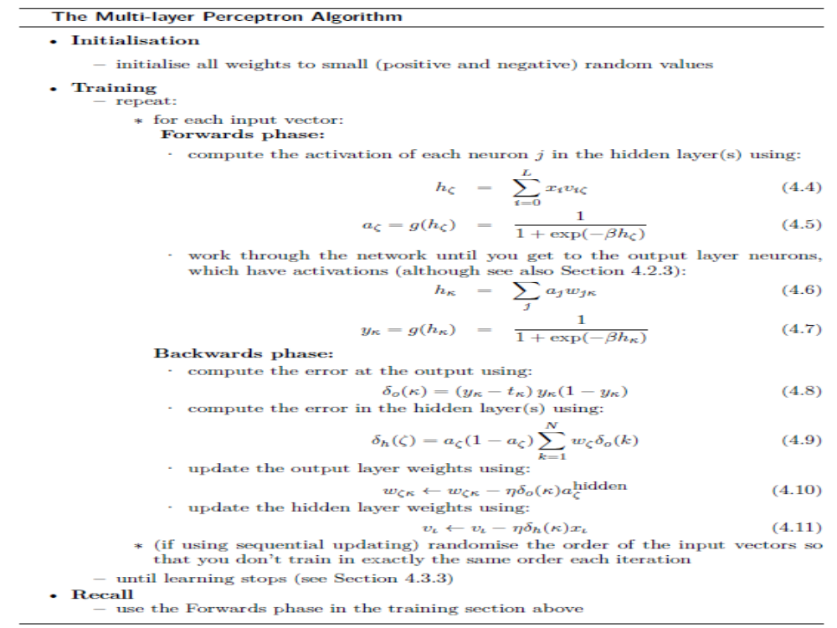

Slide 13
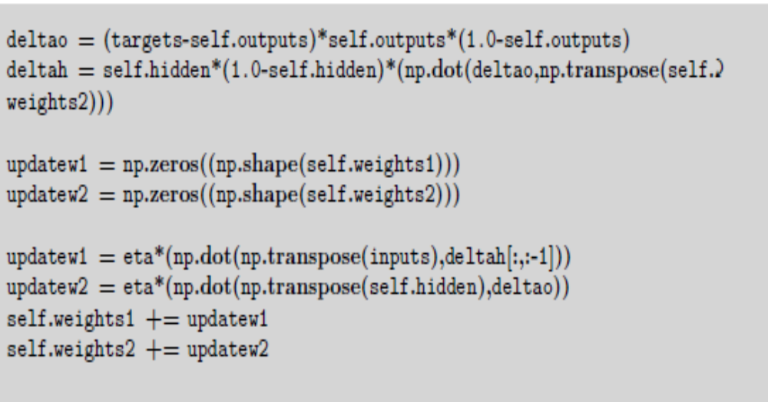
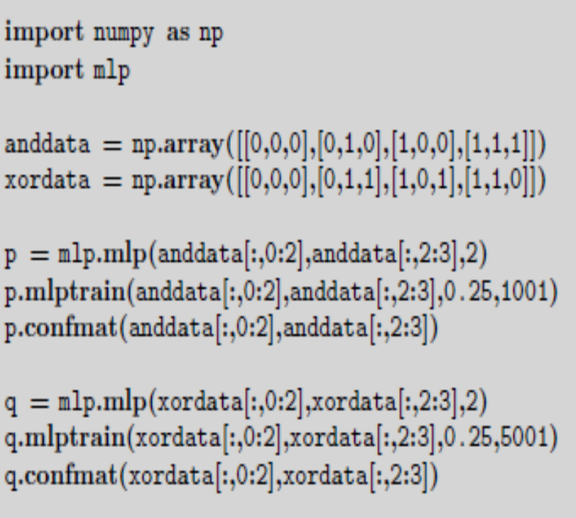
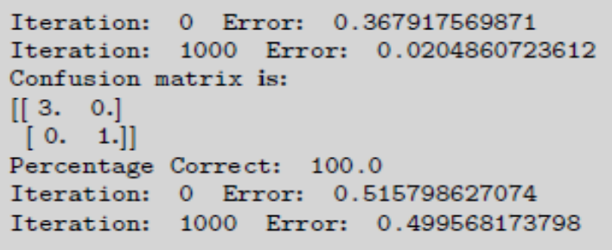
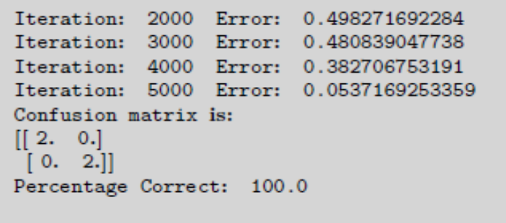

Slide 14


  Initializing the Weights
  Each neuron is getting input from n different places (either input nodes if the neuron is in the hidden layer, or hidden neurons if it is in the output layer).
  If we view the values of these inputs as having uniform variance, then the typical input to the neuron will be
  where w is the initialization value of the weights. So a common trick is to set the weights in the range
  where n is the number of nodes in the input layer to those weights.
  This makes the total input to a neuron have a maximum size of about 1.

Slide 15
  Further, if the weights are large, then the activation of a neuron is likely to be at, or close to, 0 or 1 already, which means that the gradients are small, and so the learning is very slow.
  There is an interplay here with the value of in the logistic function, which means that small values of β (say β= 3.0 or less) are more effective.
  We use random values for the initialization so that the learning starts off from different places for each run, and we keep them all about the same size because we want all of the weights to reach their final values at about the same time. This is known as uniform learning and it is important because otherwise the network will do better on some inputs than others.

Slide 16
  Different Output Activation Functions
  In the algorithm described above, we used sigmoid neurons in the hidden layer and the output layer. This is fine for classification problems, since there we can make the classes be 0 and 1.
  However, we might also want to perform regression problems, where the output needs to be from a continuous range, not just 0 or 1.
  The sigmoid neurons at the output are not very useful in that case.
  We can replace the output neurons with linear nodes that just sum the inputs and give that as their activation (so g(h) = h ).
  This does not mean that we change the hidden layer neurons; they stay exactly the same, and we only modify the output nodes.

Slide 17
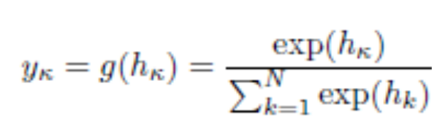
  They are not models of neurons anymore, since they don’t have the characteristic fire/don’t fire pattern.
  They enable us to solve regression problems, where we want a real number out, not just a 0/1 decision.
  Soft-max activation function is most commonly used for classification problems where the 1-of-N output encoding is used
  The soft-max function rescales the outputs by calculating the exponential of the inputs to that neuron, and dividing by the total sumof the inputs to all of the neurons, so that the activations sum to 1 and all lie between 0 and 1.
  As an activation function it can be written as:

Slide 18
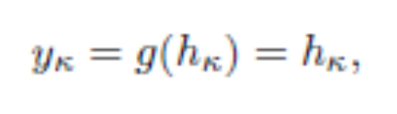

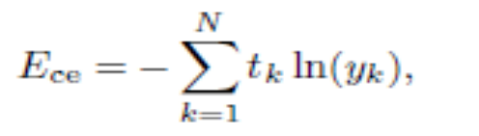
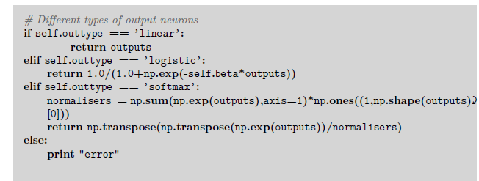
If we change the activation function, then the derivative of the activation function will also change, and so the learning rule will be different.
For the linear activation function
Derivative of this is
We can modify the error function as well, to have the cross-entropy form (where ln is the natural logarithm):

Slide 19
  Sequential and Batch Training
All of the training examples are presented to the neural network, the average sum-of-squares error is then computed, and this is used to update the weights.
Thus there is only one set of weight updates for each epoch (pass through all the training examples).
This means that we only update the weights once for each iteration of the algorithm, which means that the weights are moved in the direction that most of the inputs want them to move, rather than being pulled around by each input individually.
The batch method performs a more accurate estimate of the error gradient, and will converge to the local minimum more quickly.

Slide 20
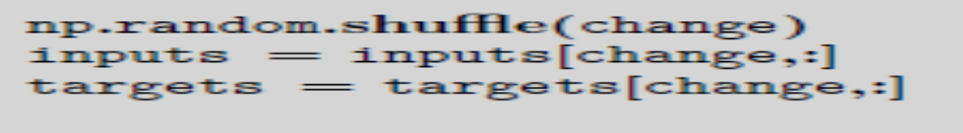
The algorithm that was described earlier was the sequential version, where the errors are computed and the weights updated after each input.
This is not guaranteed to be as efficient in learning, but it is simpler to program when using loops, and it is therefore much more common.
Since it does not converge as well, it can also sometimes avoid local minima, thus potentially reaching better solutions.
randomising the order of the input vectors at each iteration. This can significantly improve the speed with which the algorithm learns.
NumPy has a useful function that assists with this, np.random.shuffle(), which takes a list of numbers and reorders them.

Slide 21
Local Minima
There may be a much lower point over the next hill, but the ball can’t see that, and it doesn’t have enough energy to climb over the hill and find the global minimum
We don’t know where the global minimum is because we don’t know what the error landscape looks like;
we can only compute local features of it for the place we are in at the moment.
Which minimum we end up in depends on where we start.
If we begin near the global minimum, then we are very likely to end up in it, but if we start near a local minimum we will probably end up there.

Slide 22
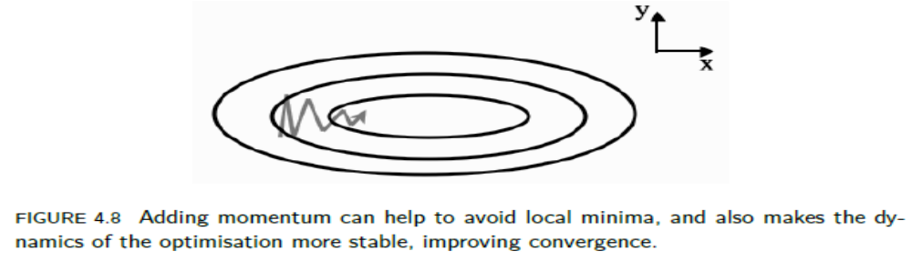
In addition, how long it will take to get to the minimum that we do find depends upon the exact appearance of the landscape at the current point.
We can make it more likely that we find the global minimum by trying out several different starting points by training several different networks, and this is commonly done.
However, we can also try to make it less likely that the algorithm will get stuck in local minima.

Slide 23
Picking Up Momentum
The reason that the ball stops rolling is because it runs out of energy at the bottom of the dip.
If we give the ball some weight, then it will generate momentum as it rolls, and so it is more likely to overcome a small hill on the other side of the local minimum, and so more likely to find the global minimum.
We can implement this idea in our neural network learning by adding in some contribution from the previous weight change that we made to the current one.
In two dimensions it will mean that the ball rolls more directly towards the valley bottom, since on average that will be the correct direction, rather than being controlled by the local changes

Slide 24
There is another benefit to momentum. It makes it possible to use a smaller learning rate, which means that the learning is more stable.
There is another benefit to momentum. It makes it possible to use a smaller learning rate, which means that the learning is more stable.
where t is used to indicate the current update and t − 1 is the previous one. 0 < α < 1 is the momentum constant. Typically a value of = 0.9 is used.
Another thing that can be added is known as weight decay. This reduces the size of the weights as the number of iterations increases.
After each learning iteration through all of the input patterns, every weight is multiplied by some constant 0 < ε < 1. This makes the network simpler and can often produce improved results,

Slide 25
Minibatches and Stochastic Gradient Descent
Batch algorithm converges to a local minimum faster than the sequential algorithm, which computes the error for each input individually and then does a weight update, but that the latter is sometimes less likely to get stuck in local minima.
The reason for both of these observations is that the batch algorithm makes a better estimate of the steepest descent direction, so that the direction it chooses to go is a good one, but this just leads to a local minimum.
The idea of a minibatch method is by splitting the training set into random batches, estimating the gradient based on one of the subsets of the training set, performing a weight update, and then using the next subset to estimate a new gradient and using that for the weight update, until all of the training set have been used.

Slide 26
a single input vector is chosen from the training set, and the output and hence the error for that one vector computed, and this is used to estimate the gradient and so update the weights.
A new random input vector (which could be the same as the previous one) is then chosen and the process repeated.
This is known as stochastic gradient descent, and can be used for any gradient descent problem, not just the MLP.
It is often used if the training set is very large, since it would be very expensive to use the whole dataset to estimate the gradient in that case.

Slide 27
Other Improvements: One is to reduce the learning rate as the algorithm progresses. The reasoning behind this is that the network should only be making large-scale changes to the weights at the beginning, when the weights are random; if it is still making large weight changes later on, then something is wrong.
Second derivatives of the error with respect to the weights

Slide 28
THE MULTI-LAYER PERCEPTRON IN PRACTICE: Amount of Training Data :
For the MLP with one hidden layer there are (L + 1) ×M + (M + 1) × N weights, where L,M,N are the number of nodes in the input, hidden, and output layers, respectively.
The extra +1s come from the bias nodes, which also have adjustable weights.
This is a potentially huge number of adjustable parameters that we need to set during the training phase.
Setting the values of these weights is the job of the back-propagation algorithm, which is driven by the errors coming from the training data.
Clearly, the more training data there is, the better for learning, although the time that the algorithm takes to learn increases.

Slide 29
Unfortunately, there is no way to compute what the minimum amount of data required is, since it depends on the problem.
A rule of thumb that has been around for almost as long as the MLP itself is that you should use a number of training examples that is at least 10 times the number of weights.
This is probably going to be a very large number of examples, so neural network training is a fairly computationally expensive operation, because we need to show the network all of these inputs lots of times.
Number of Hidden Layers:
it is possible to show mathematically that one hidden layer with lots of hidden nodes is sufficient. This is known as the Universal Approximation Theorem;

Slide 30
You just have to experiment by training networks with different numbers of hidden nodes and then choosing the one that gives the best results
we will never normally need more than two layers (that is, one hidden layer and the output layer). This is because we can approximate any smooth functional mapping using a linear combination of localised sigmoidal functions.
The basic idea is that by combining sigmoid functions we can generate ridge-like functions, and by combining ridge-like functions we can generate functions with a unique maximum.
By combining these and transforming them using another layer of neurons, we obtain a localised response (a ‘bump’ function), and any functional mapping can be approximated to arbitrary accuracy using a linear combination of such bumps.

Slide 31
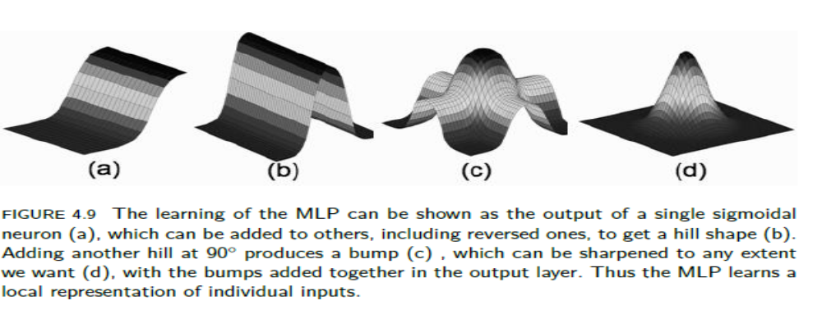
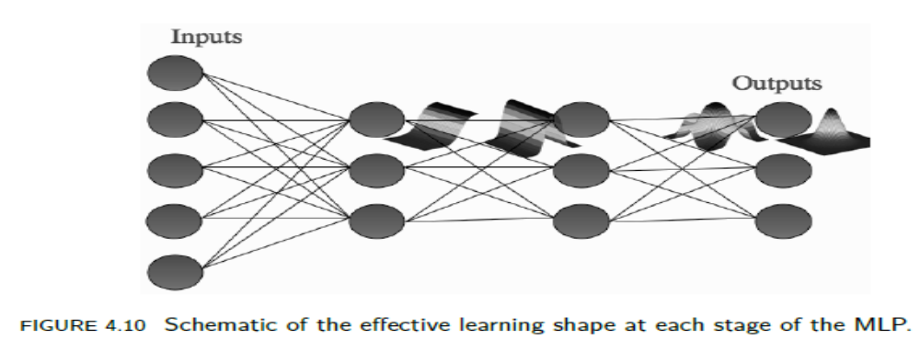

Slide 32
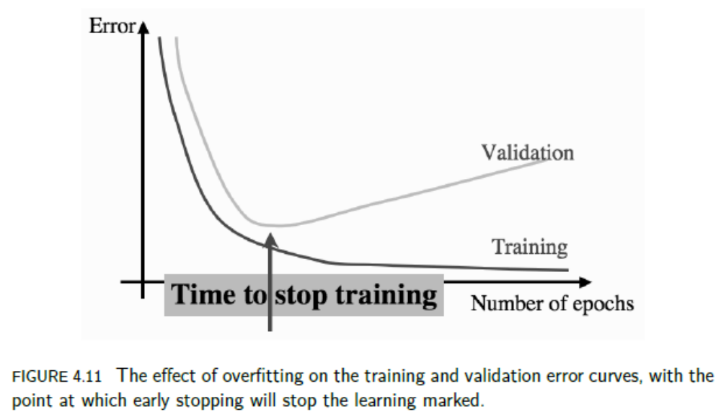
When to Stop Learning

Slide 33
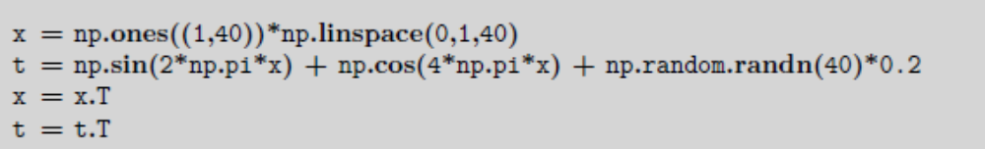
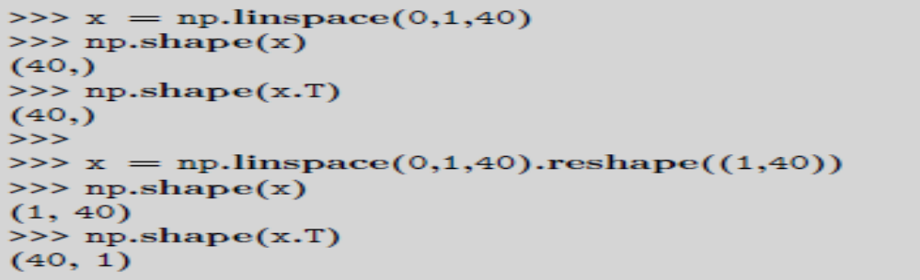
EXAMPLES OF USING THE MLP
A Regression Problem
We will take a set of samples generated by a simple mathematical function, and try to learn the generating function (that describes how the data was made) so that we can find the values of any inputs, not just the ones we have training data for.

Slide 34
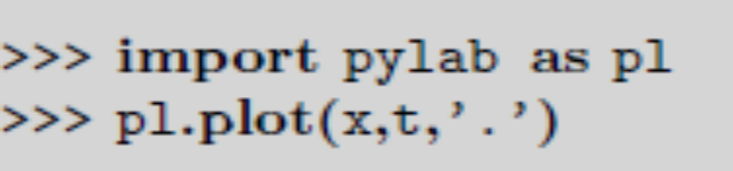
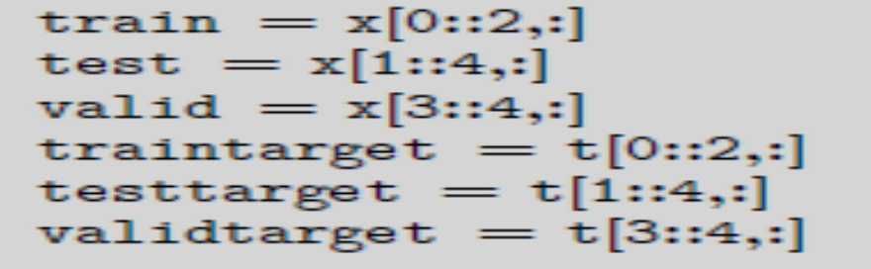
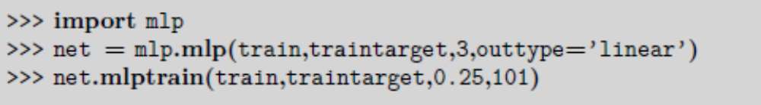
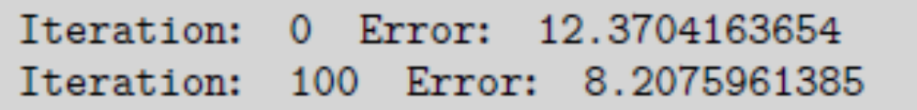
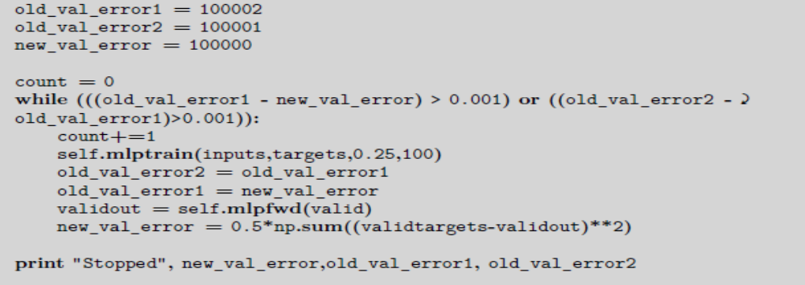

Slide 35
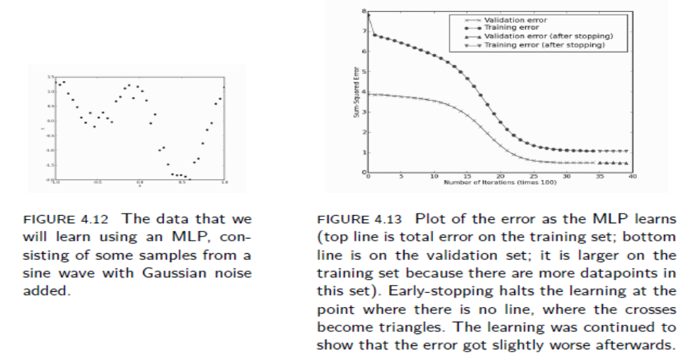
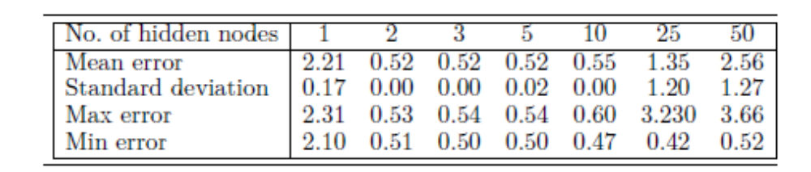

Slide 36
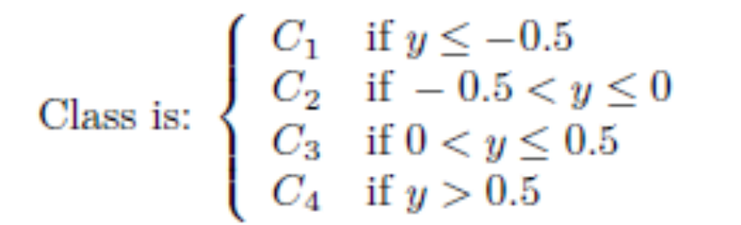
Classification with the MLP
There are a couple of choices for the outputs. The first is to use a single linear node for the output, y, and put some thresholds on the activation value of that node.
A more suitable output encoding is called 1-of-N encoding.
A separate node is used to represent each possible class, and the target vectors consist of zeros everywhere except for in the one element that corresponds to the correct class, e.g., (0, 0, 0, 1, 0, 0) means that the correct result is the 4th class out of 6.
We are therefore using binary output values (we want each output to be either 0 or 1).

Slide 37

Simply choose the element yk of the output vector that is the largest element of y (in mathematical notation, pick the yk for which o so this statement says pick the yk that is bigger than all other possible values yj ).
This generates an unambiguous decision, since it is very unlikely that two output neurons will have identical largest output values.
This is known as the hard-max activation function (since the neuron with the highest activation is chosen to fire and the rest are ignored).
An alternative is the soft-max function, which has the effect of scaling the output of each neuron according to how large it is in comparison to the others, and making the total output sum to 1.

Slide 38
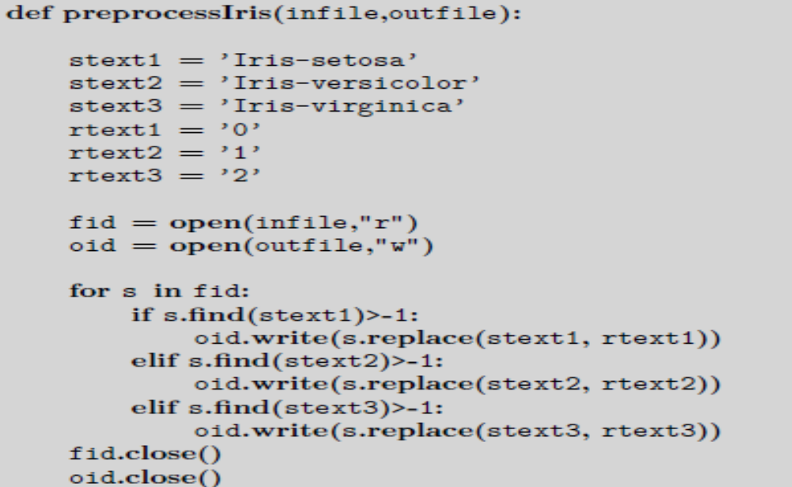
A Classification Example: The Iris Dataset
Classifying examples of three types of iris (flower) by the length and width of the sepals and petals and is called iris.

Slide 39
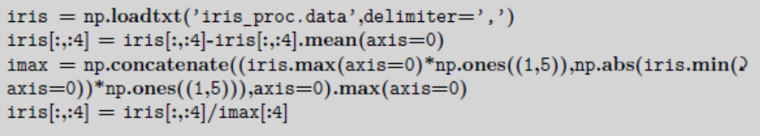
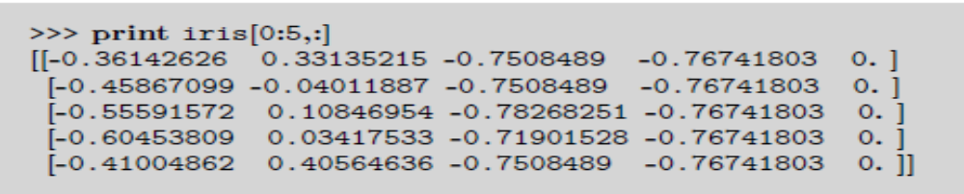
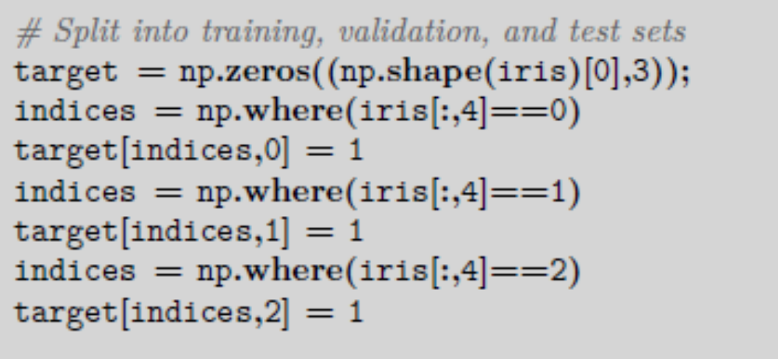

Slide 40
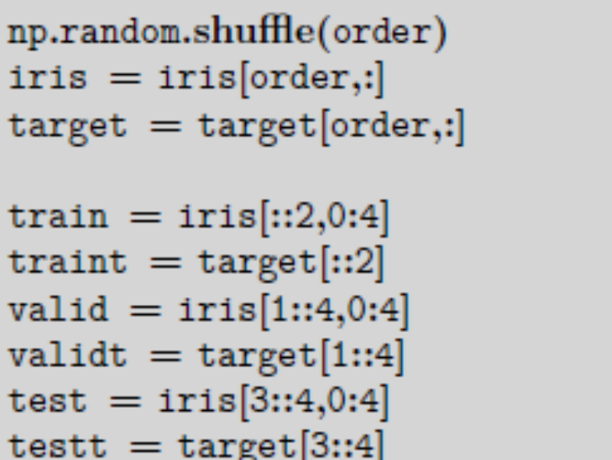
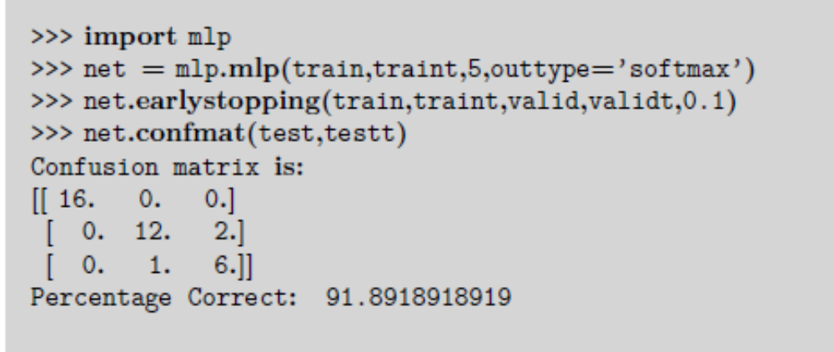

Slide 41
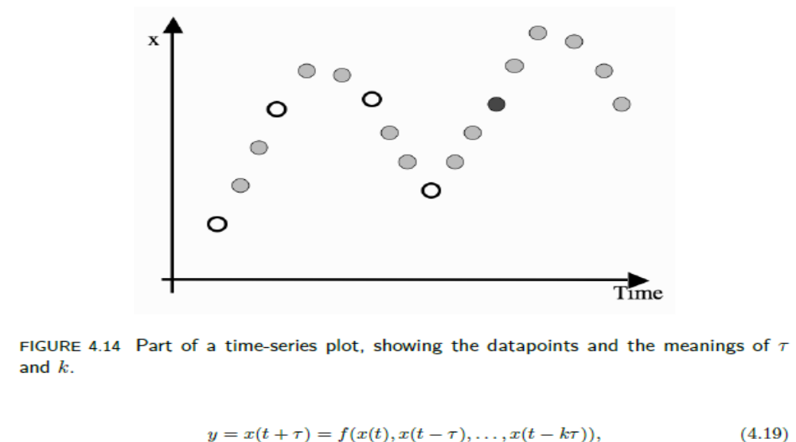
Time-Series Prediction
The target data for training the neural network is simple, because it comes from further up the time-series, and so training is easy. Suppose that = 2 and k = 3.

Slide 42

2855 data points. To minimise the sum-of-squares error. Since there are no classes, the confusion matrix is not useful

Slide 43
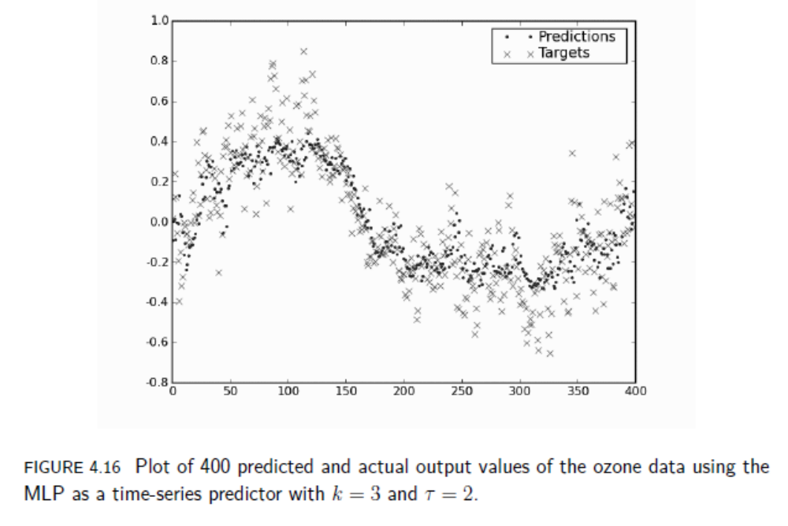

Slide 44
Data Compression: The Auto-Associative Network
Suppose that we train the network to reproduce the inputs at the output layer (called auto-associative learning; sometimes the network is known as an autoencoder).
The network is trained so that whatever you show it at the input is reproduced at the output.
This bottleneck hidden layer has to represent all of the information in the input, so that it can be reproduced at the output.
It therefore performs some compression of the data, representing it using fewer dimensions than were used in the input.
They are finding a different (often lower dimensional) representation of the input data that extracts important components of the data, and ignores the noise.

Slide 45
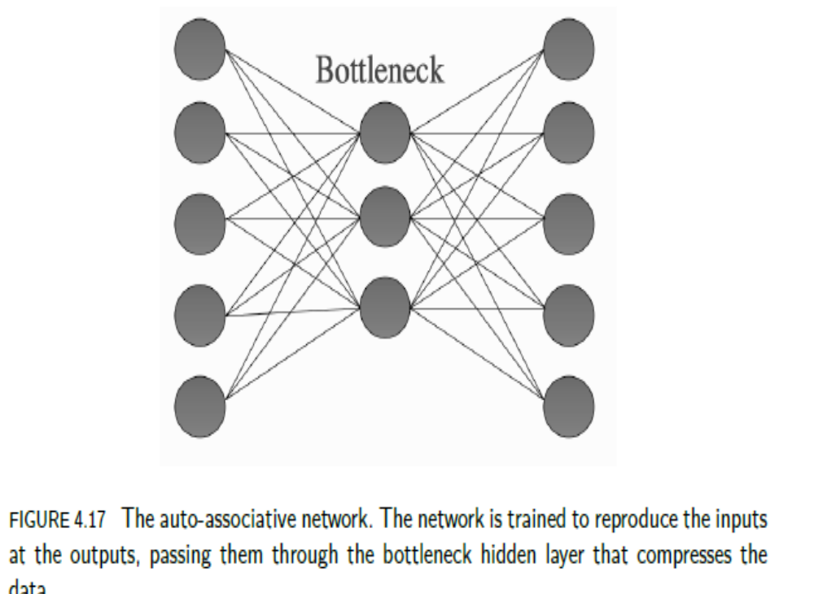

Slide 46
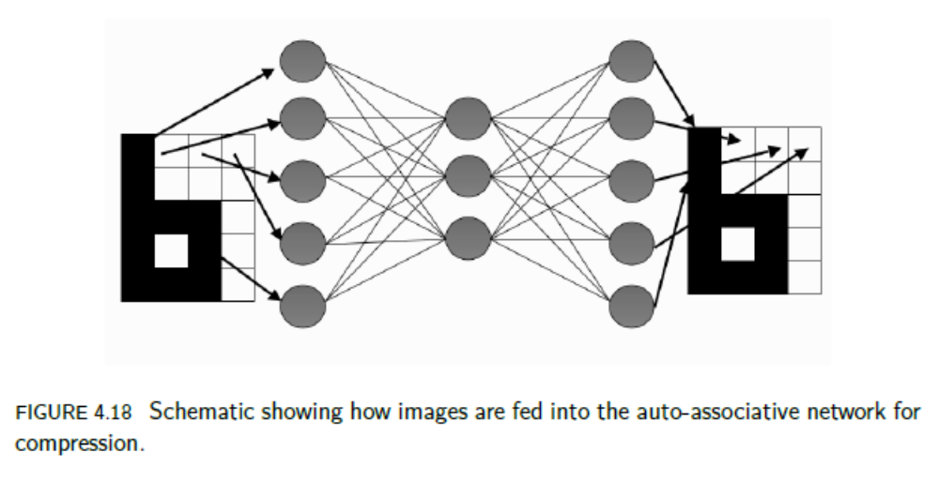

Slide 47
A RECIPE FOR USING THE MLP
Select inputs and outputs for your problem
Normalise inputs
Split the data into training, testing, and validation sets
Select a network architecture
Train a network
Test the network

